Slide 1
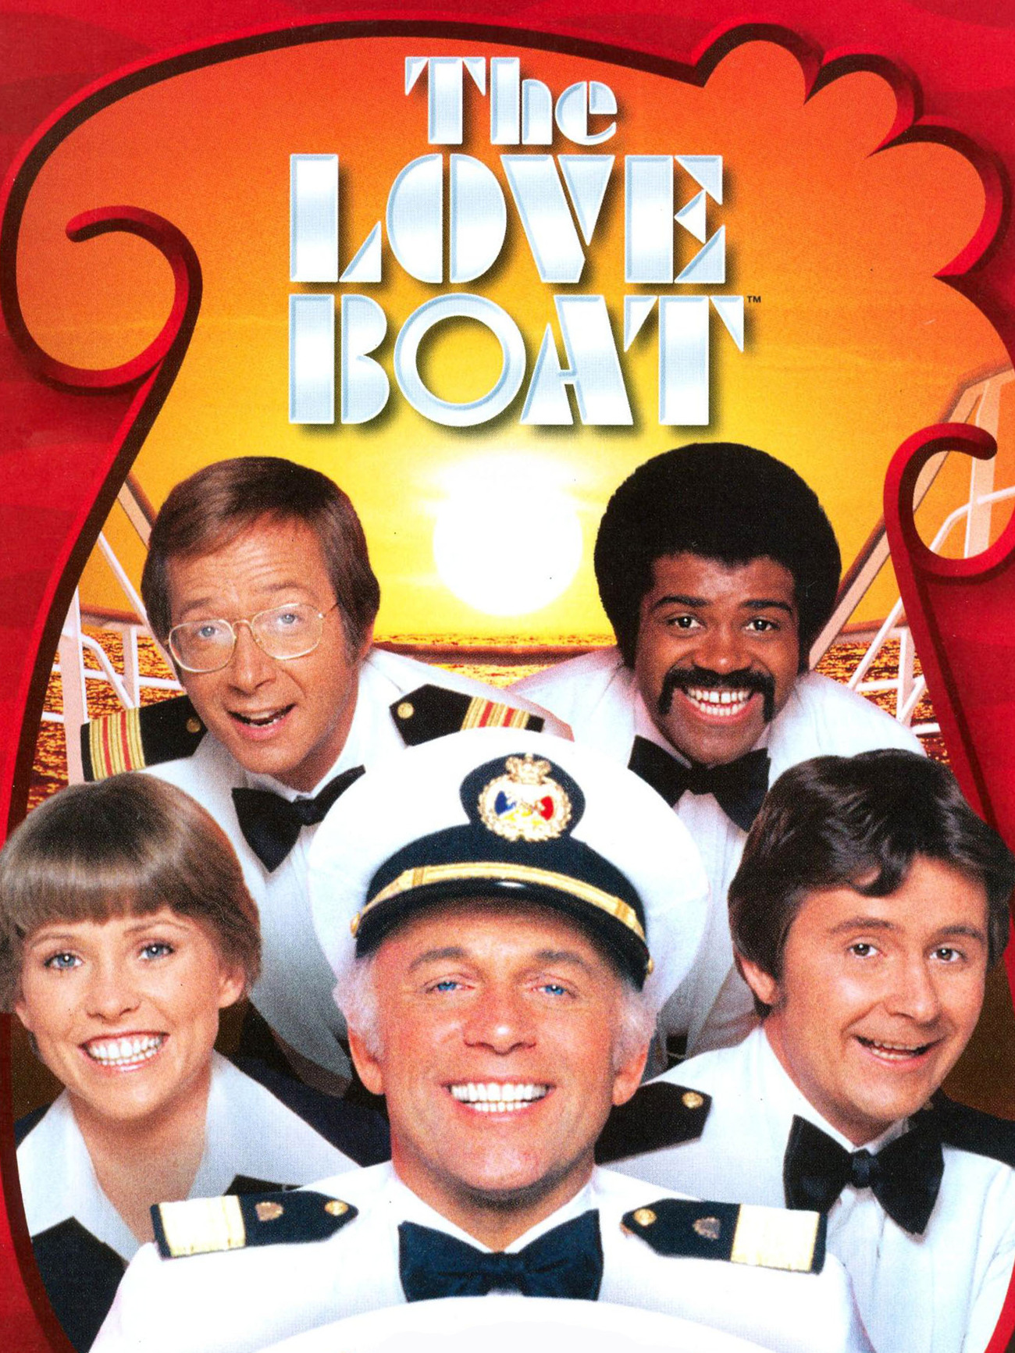
Love Boat
Bank Security
Neil Seward, Patrick Smuk, Rob Cole, Kevin ho

Slide 2
Problem
The government wants to plan the designs for a new bank.
They have provided blueprints of the floor layout, which includes all of the walls inside.
The government wants to save the most amount of money for these measures, but at the same time provide the most amount of security possible

Slide 3
FUNCTIONAL REQUIREMENTS
Program uses 12x12 matrix as input from text file
Program uses equipment security JSON file as equipment parameters
Marks areas on the blueprint to place the equipment
Assume range cannot go through walls
Marks range covered by the security equipment
Marks overlap between two or more ranges of equipment
All areas of the bank are covered by at least on piece of equipment
Program creates a floor plan that maximizes coverage, while minimizes overall cost

Slide 4
Approach
Our group decided to use a variation of Extreme Programming (XP). We had one main coder that coded the application while several other people in the group provided critique and guidance in the development effort.
The division of effort allowed us to work on the presentation documents, the aesthetics, the algorithm, and the design documents all in parallel.
XP also allowed us to constantly improve and evaluate prototypes as we coded.

Slide 5
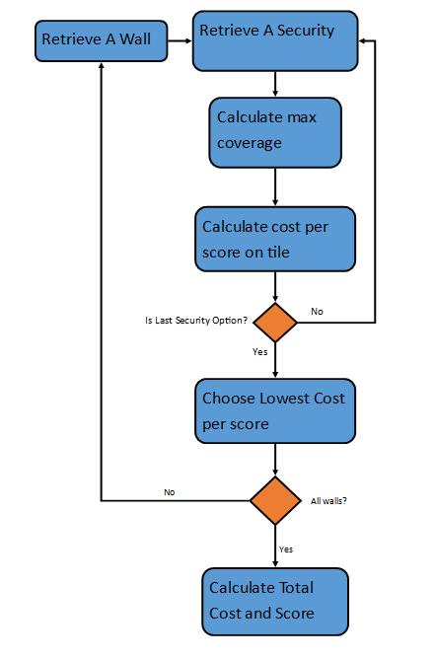
Algorithm DESIGN
We decided to do a simple algorithm to minimize equipment cost, while providing maximum coverage and the highest score.
Our algorithm evaluates which shape at each wall will give the lowest cost / score

Slide 6
Interface
We made our interface using the Love2D framework for the language Lua
Love2D is an open source video game framework
All images were manually created

Slide 7
DEMO

